Slide 1

Chapter 5 – System Modeling
Chapter 5 System modeling

Slide 2
Topics covered
Unified modeling language
Context models
Interaction models
Structural models
Behavioral models
Model-driven engineering
Chapter 5 System modeling

Slide 3
System modeling
System modeling is the process of developing abstract models of a system, with each model presenting a different view or perspective of that system.
System modeling has now come to mean representing a system using some kind of graphical notation, which is now almost always based on notations in the Unified Modeling Language (UML).
System modelling helps the analyst to understand the functionality of the system and models are used to communicate with customers.
Chapter 5 System modeling

Slide 4
UML
The UML combines the best of the best from
Data Modelling concepts (Entity Relationship Diagrams)
Business Modelling (work flow)
Object Modelling
Component Modelling
The UML is the standard language for visualizing, specifying, constructing, and documenting the artifacts of a software-intensive system
It can be used with all processes, throughout the development life cycle, and across different implementation technologies
Notes:
Core message -- second bullet
UML can be used to communicate system and software design throughout the life cycle

Slide 5
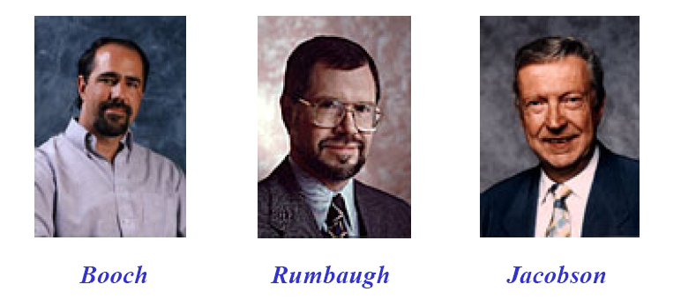
UML Sponsors
-Grady Booch, Jim Rumbaugh, IvarJacobson
-Based on Boochmethod, OMT, OOSE

Slide 6
UML and other methods
UML | Other methods
Use case model | Use case of OOSE
Class diagram | Class diagram of OMT, Booch
State diagram | State diagram proposed by David Harel
Activity diagram | Work flow model used in many methods
Cooperation diagram | Object interaction of Booch and Fusion methods
Component and deployment diagram | Module and process diagram in Booch method
Chapter 5 System modeling

Slide 7
UML Concepts
The UML may be used to:
Display the boundary of a system & its major functions using use cases and actors
Illustrate use case realizations with interaction diagrams
Represent a static structure of a system using class diagrams
Model the behavior of objects with state transition diagrams
Reveal the physical implementation architecture with component & deployment diagrams
Extend your functionality with stereotypes
Notes:
The last set of slides briefly introduces most of the UML notations.
NOTE: Not all notations are covered due to time constraints

Slide 8
The elements of UML
Things
Class, interface, package, component etc.
Relationships
Generalization, dependency, association, realization
Diagrams
Be made of things and relationships.
Use case diagram, class diagram, sequence diagrams … and other diagrams.
Rules
Name, scope ,some constraints

Slide 9
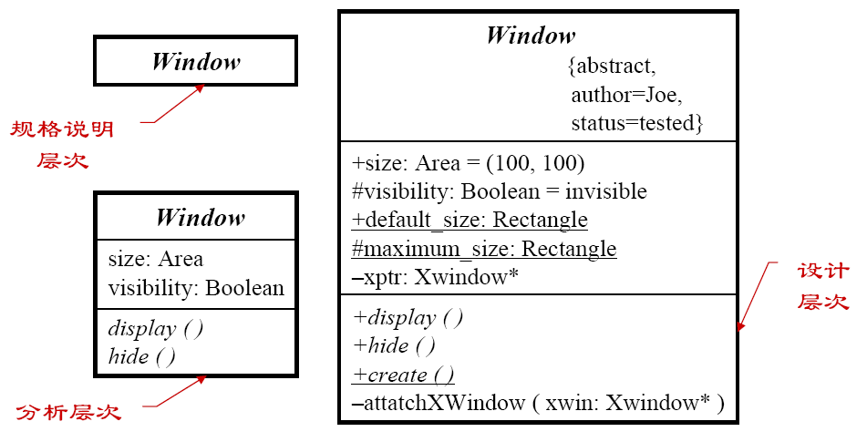
Structural thing: Object classes
Classes in different abstraction

Slide 10
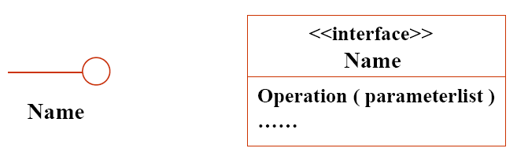
Structural thing : interfaces
The services set of a class or a component
Description of a external behavior of a class or a component

Slide 11
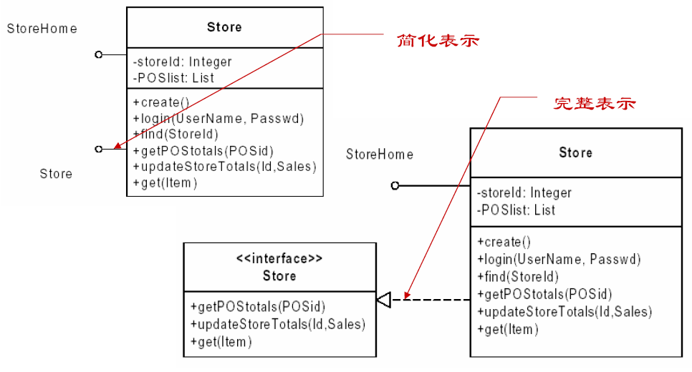
Examples of interface

Slide 12
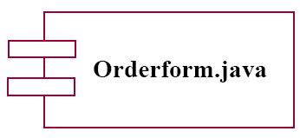
Structural thing : Components
Physical parts in system

Slide 13
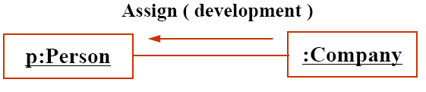
Behavioral thing: interaction
Communication between objects

Slide 14
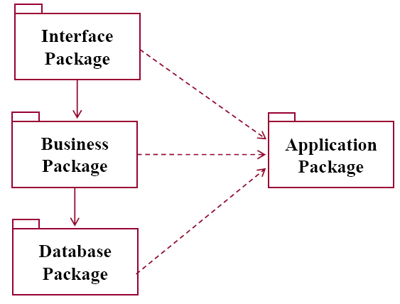
Grouping thing: package
Organize some things into a group

Slide 15
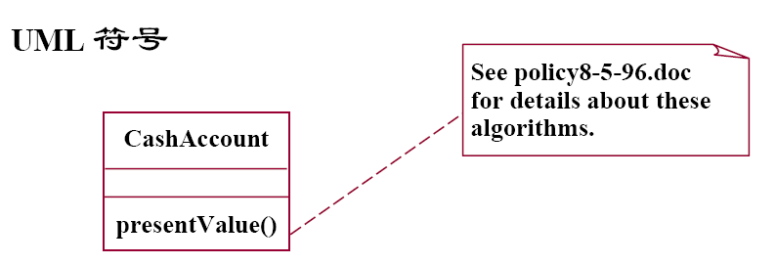
Comment thing: comment

Slide 16
UML relationships
Association
Generalization
Dependency
Realization

Slide 17
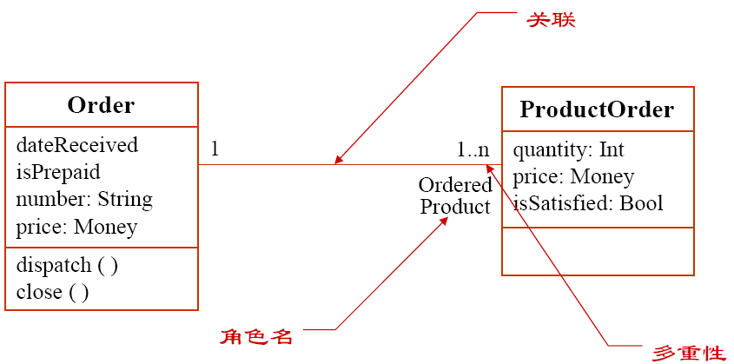
Association

Slide 18
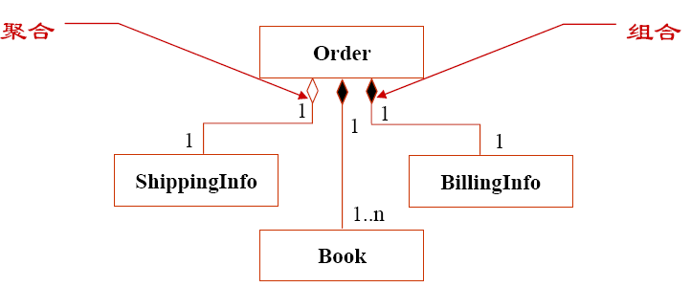
Aggregation and Composition
Special association

Slide 19
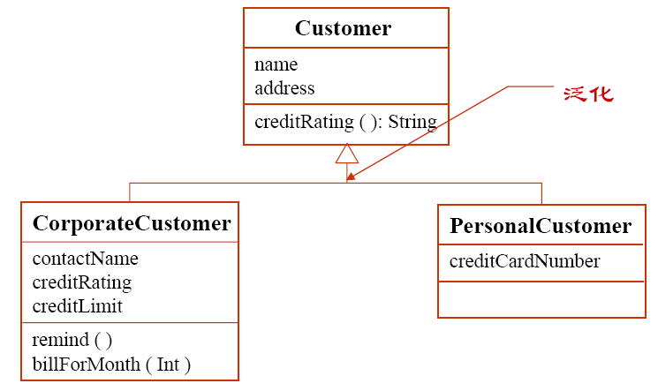
Generalization
A relationship to show general and special

Slide 20
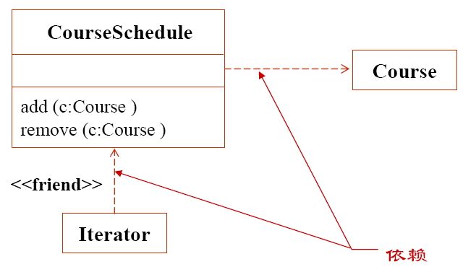
Dependency
Reflect the relationship that of one thing will be affected by another.

Slide 21
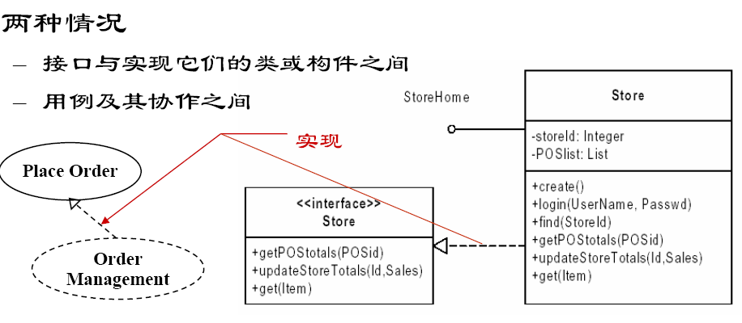
Realization
A part is realized by another

Slide 22
UML diagrams
Use case diagram Functional model
Class diagram
Object diagram
Component diagram
Deployment diagram Structural model
Sequence diagram
Collaboration diagram
State diagram
Activity diagram Behavioral model

Slide 23
Existing and planned system models
Models of the existing system are used during requirements engineering. They help clarify what the existing system does and can be used as a basis for discussing its strengths and weaknesses. These then lead to requirements for the new system.
Models of the new system are used during requirements engineering to help explain the proposed requirements to other system stakeholders. Engineers use these models to discuss design proposals and to document the system for implementation.
In a model-driven engineering process, it is possible to generate a complete or partial system implementation from the system model.
Chapter 5 System modeling

Slide 24
Use of graphical models
As a means of facilitating discussion about an existing or proposed system
Incomplete and incorrect models are OK as their role is to support discussion.
As a way of documenting an existing system
Models should be an accurate representation of the system but need not be complete.
As a detailed system description that can be used to generate a system implementation
Models have to be both correct and complete.
Chapter 5 System modeling

Slide 25
System perspectives
An external perspective, where you model the context or environment of the system.
An interaction perspective, where you model the interactions between a system and its environment, or between the components of a system.
A structural perspective, where you model the organization of a system or the structure of the data that is processed by the system.
A behavioral perspective, where you model the dynamic behavior of the system and how it responds to events.
Chapter 5 System modeling

Slide 26
Use of UML diagrams
Activity diagrams
Show the activities involved in a process or in data processing
Use case diagrams
Show the interactions between a system and its environments
Sequence diagrams
Show interactions between system components
Class diagrams
Show static relationships between classes
State diagrams
Show how the system reacts to internal & external events
Chapter 5 System modeling

Slide 27
Context models
Context models are used to illustrate the operational context of a system - they show what lies outside the system boundaries.
Social and organisational concerns may affect the decision on where to position system boundaries.
Architectural models show the system and its relationship with other systems.
Chapter 5 System modeling

Slide 28
System boundaries
System boundaries are established to define what is inside and what is outside the system.
They show other systems that are used or depend on the system being developed.
The position of the system boundary has a profound effect on the system requirements.
Defining a system boundary is a political judgment
There may be pressures to develop system boundaries that increase / decrease the influence or workload of different parts of an organization.
Chapter 5 System modeling

Slide 29
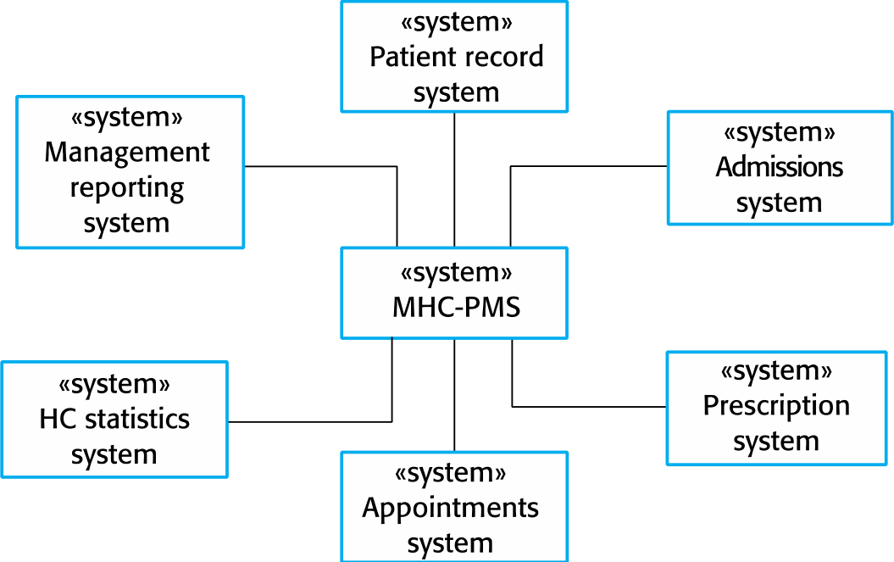
The context of the Mentcare
<<system>>
Mentcare
Chapter 5 System modeling

Slide 30
Process perspective
Context models simply show the other systems in the environment, not how the system being developed is used in that environment.
Process models reveal how the system being developed is used in broader business processes.
UML activity diagrams may be used to define business process models.
Chapter 5 System modeling

Slide 31
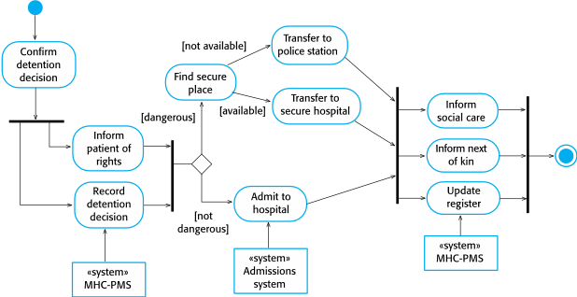
Process model of involuntary detention
Chapter 5 System modeling
Notes:
Detention:滞留

Slide 32
Interaction models
Modeling user interaction is important as it helps to identify user requirements.
Modeling system-to-system interaction highlights the communication problems that may arise.
Modeling component interaction helps us understand if a proposed system structure is likely to deliver the required system performance and dependability.
Use case diagrams and sequence diagrams may be used for interaction modeling.
Chapter 5 System modeling

Slide 33
Use case modeling
Use cases were developed originally to support requirements elicitation and now incorporated into the UML.
Each use case represents a discrete task that involves external interaction with a system.
Actors in a use case may be people or other systems.
Represented diagramatically to provide an overview of the use case and in a more detailed textual form.
Chapter 5 System modeling

Slide 34
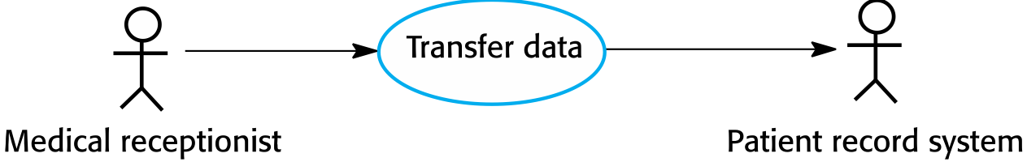
Transfer-data use case
A use case in the MHC-PMS
Chapter 5 System modeling

Slide 35
Tabular description of the ‘Transfer data’ use-case
MHC-PMS: Transfer data
Actors | Medical receptionist, patient records system (PRS)
Description | A receptionist may transfer data from the MHC-PMS to a general patient record database that is maintained by a health authority. The information transferred may either be updated personal information (address, phone number, etc.) or a summary of the patient’s diagnosis and treatment.
Data | Patient’s personal information, treatment summary
Stimulus | User command issued by medical receptionist
Response | Confirmation that PRS has been updated
Comments | The receptionist must have appropriate security permissions to access the patient information and the PRS.
Chapter 5 System modeling

Slide 36
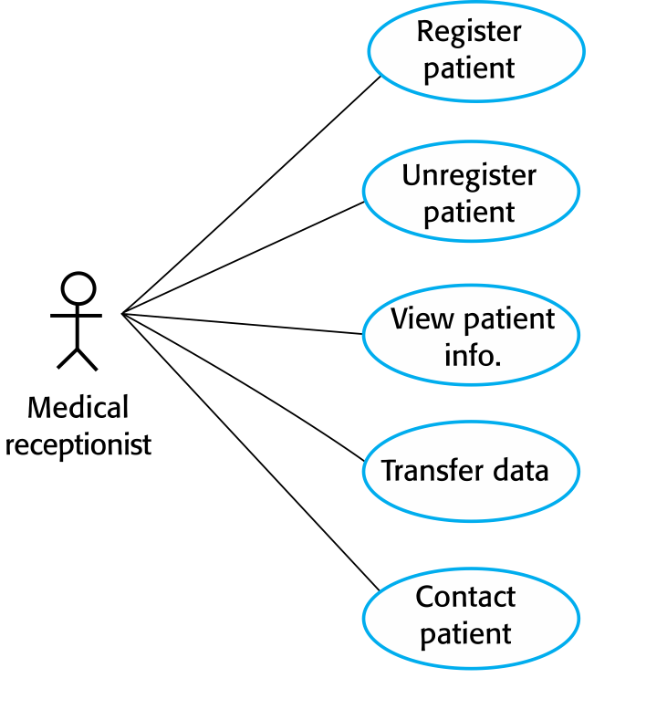
Use cases in the MHC-PMS involving the role ‘Medical Receptionist’
Chapter 5 System modeling

